Slide 1
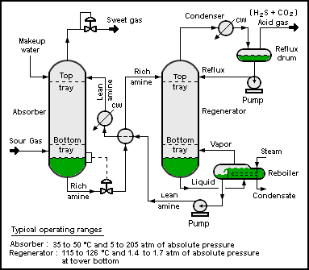
Zoom Shape 1
Zoom Shape 3
Zoom Shape 2

Slide 2
